Slide 1
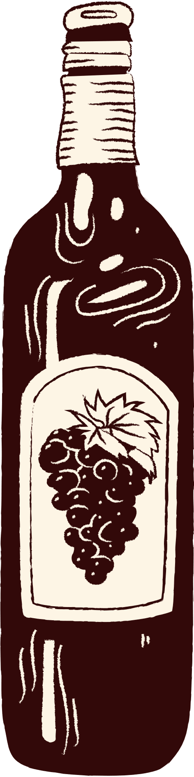
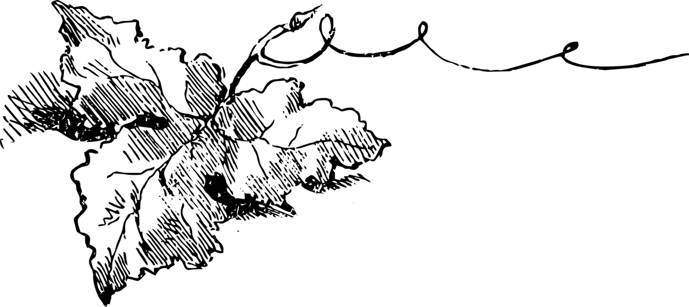


Group 3
Getting
drunk
A Graduate Student’s Guide to Surviving April
Chikai Jiang, Li Jiang, Qinghua Li, Julian Sim, Hongyu Yu

Slide 2


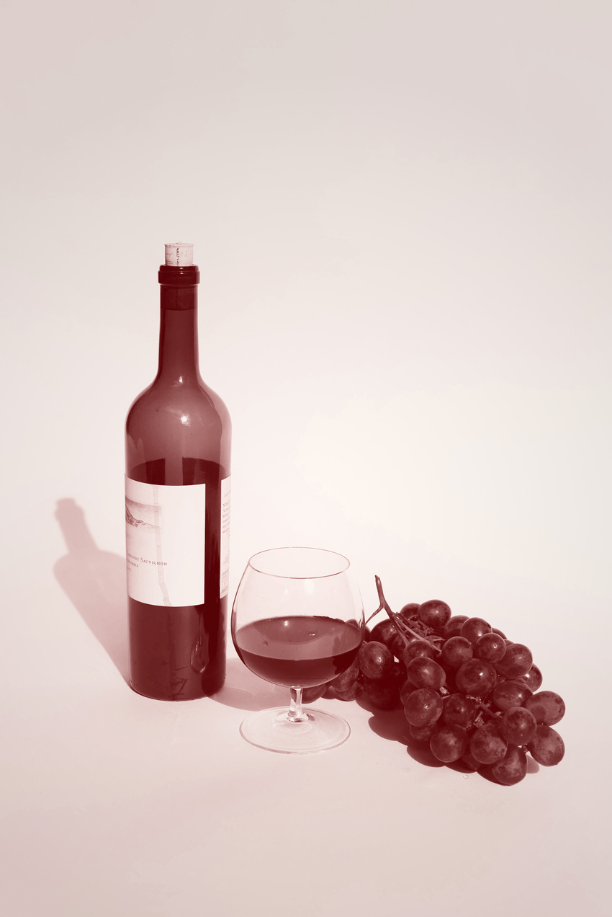
Table Of Contents
01
Introduction
02
Methodology
03
Conclusion
The Problem
The Solution
Data Description
Logistic Regression
Bayesian MCMC
Newton Raphson
SVM & MLP
Comparison
Conclusions
Future Work

Slide 3
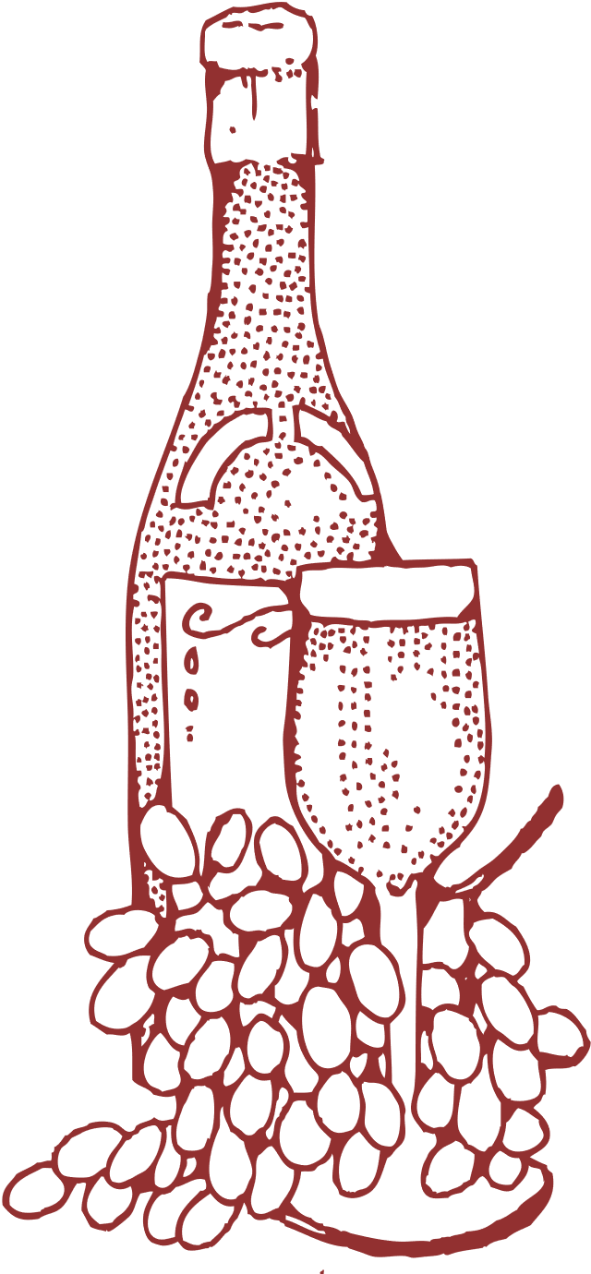

The Problem
Graduate students don’t have much money and therefore need to choose good wines with limited financial resources.
However, many grad students don’t know what a “good wine” is.
Wine taste may be subjective, but there is growing interest in identifying objective qualities that contribute to wine quality or at least identifying qualities that experts believe make a good wine.

Slide 4

The Solution
Leverage the Vinho Verde Wine Quality Dataset from the UCI Machine Learning Repository to address the following questions:
What chemical properties are most indicative of a good* wine?
What chemical properties are predictive of a wine’s color?
Determine whether different chemical properties are valued in different color wines.
* Within this dataset, wine quality scores are provided by expert assessors on a scale from 3 to 9, but for the purpose of model comparison, it was dichotomized at ≥ 7.
.

Slide 5



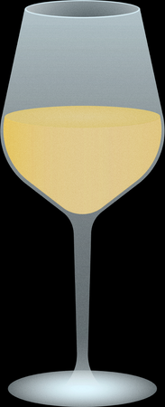

Covariates
Acids
Stabilizers
Fixed Acids remain in a wine when it’s boiled
Volatile Acids evaporate
Citric Acid is a fixed acid, traditionally the acid of choice to boost wine acidity
Free SO2: SO2 still available to protect wine, ensures freshness and stability of wine
Total SO2: Includes already reacted SO2, affects taste and relevant for legal limits
Sugars
Alcohol
Residual sugar is the sugar remaining in wine after fermentation, directly affects sweetness
Density: A measure of fermentation, wines grow less dense with fermentation
Alcohol: Another measure of fermentation, directly measures the amount of alcohol present
Salts
Acidity
Chlorides are indicative of sodium chloride content in wines
Sulphates are salts or esters of sulfuric acid, naturally occurring
pH: Affects taste, color, and stability. Lower pH wines are “sharper” and higher pH wines have softer notes.

Slide 6
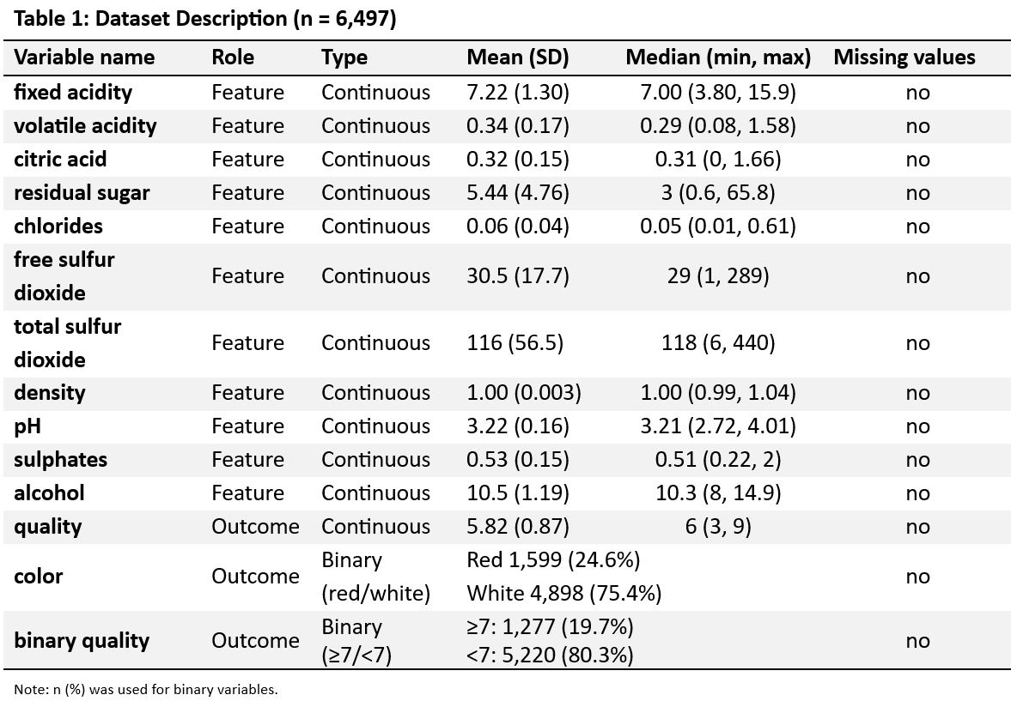
Data Description (n=6497)

Slide 7
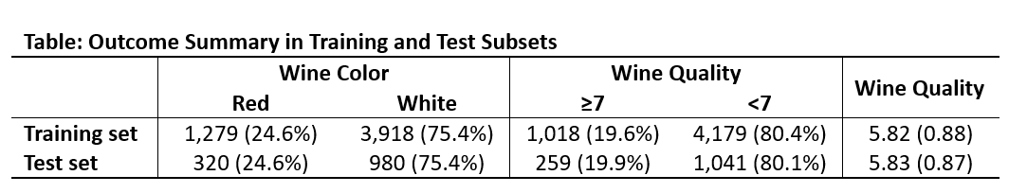
Data Exploration
Start off by splitting 80% of the data into a train set and 20% into a test set. Then, use the training set to build models with cross validation of k = 10 where possible, and then utilize the test set to ascertain model performance.

Slide 8
01
Introduction
02
Methodology
03
Conclusion
The Problem
The Solution
Data Description
Logistic Regression
Bayesian MCMC
Newton Raphson
SVM & MLP
Comparison
Conclusions
Future Work

Slide 9


Logistic regression
Start off simple – fit a simple logistic regression model with all the covariates!

Slide 10
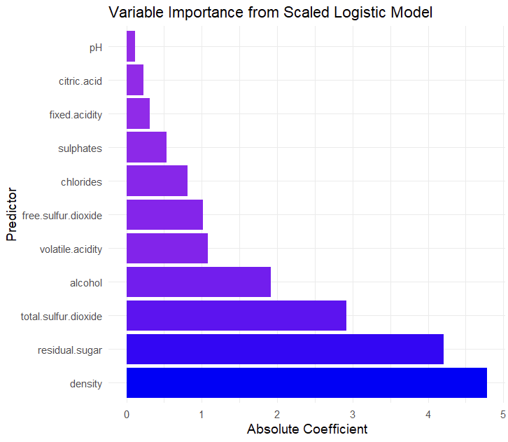
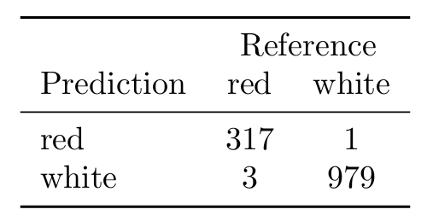
Outcome: Wine Color

Slide 11
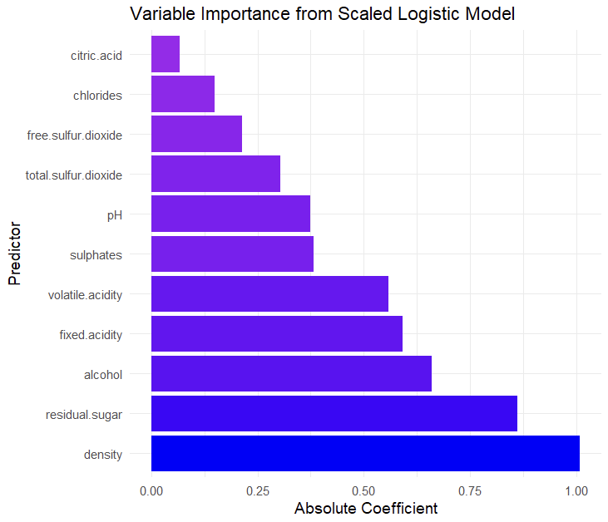
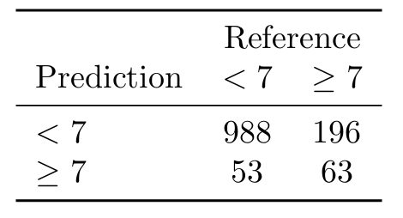
Outcome: Wine Quality

Slide 12
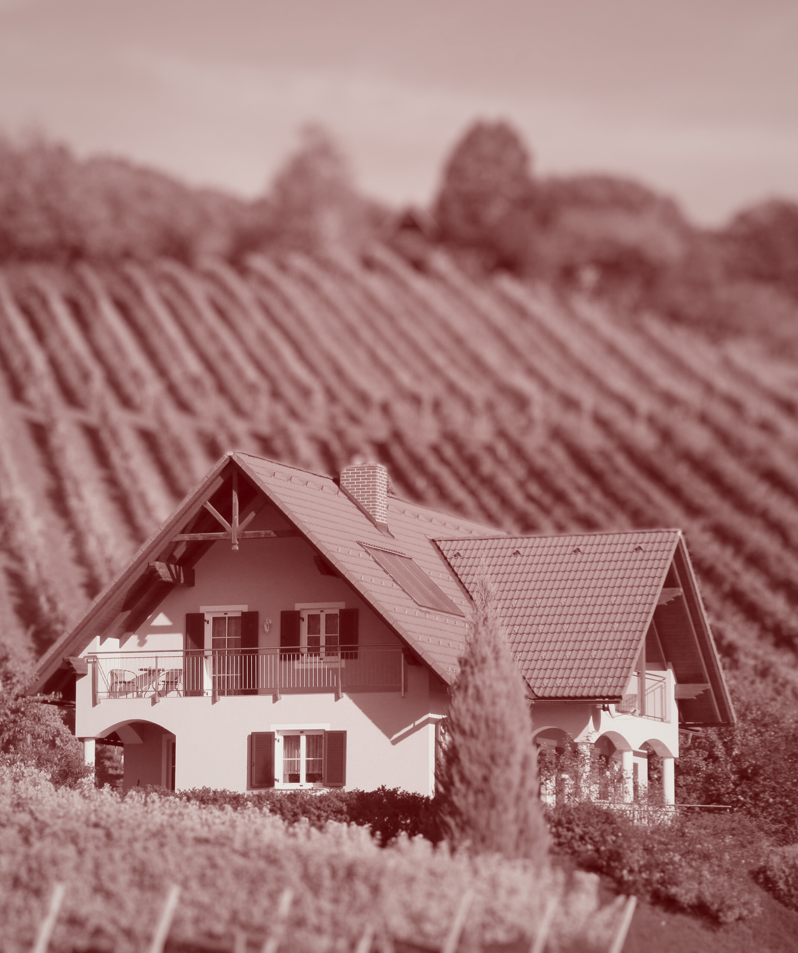
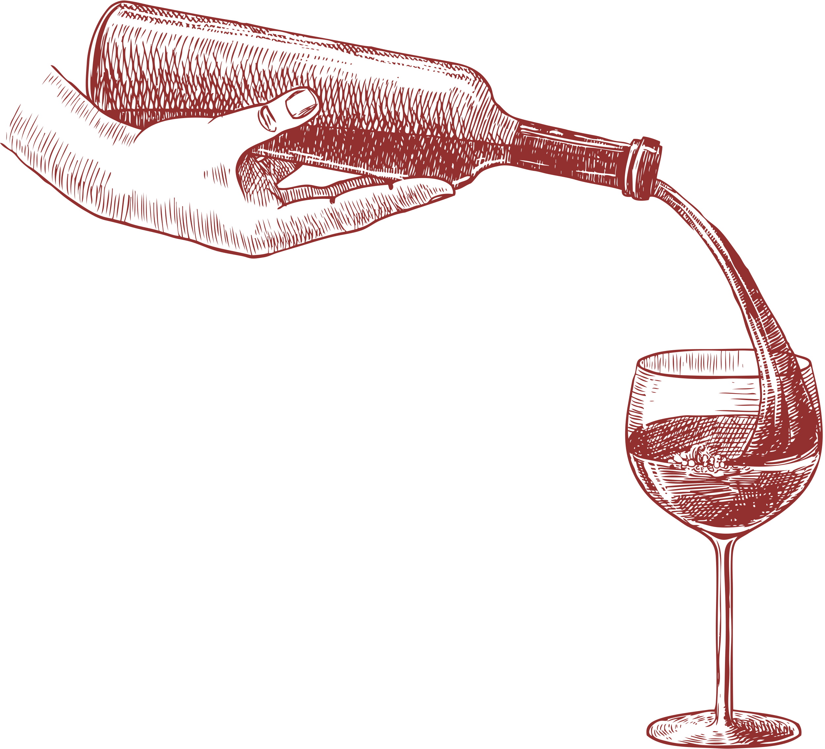
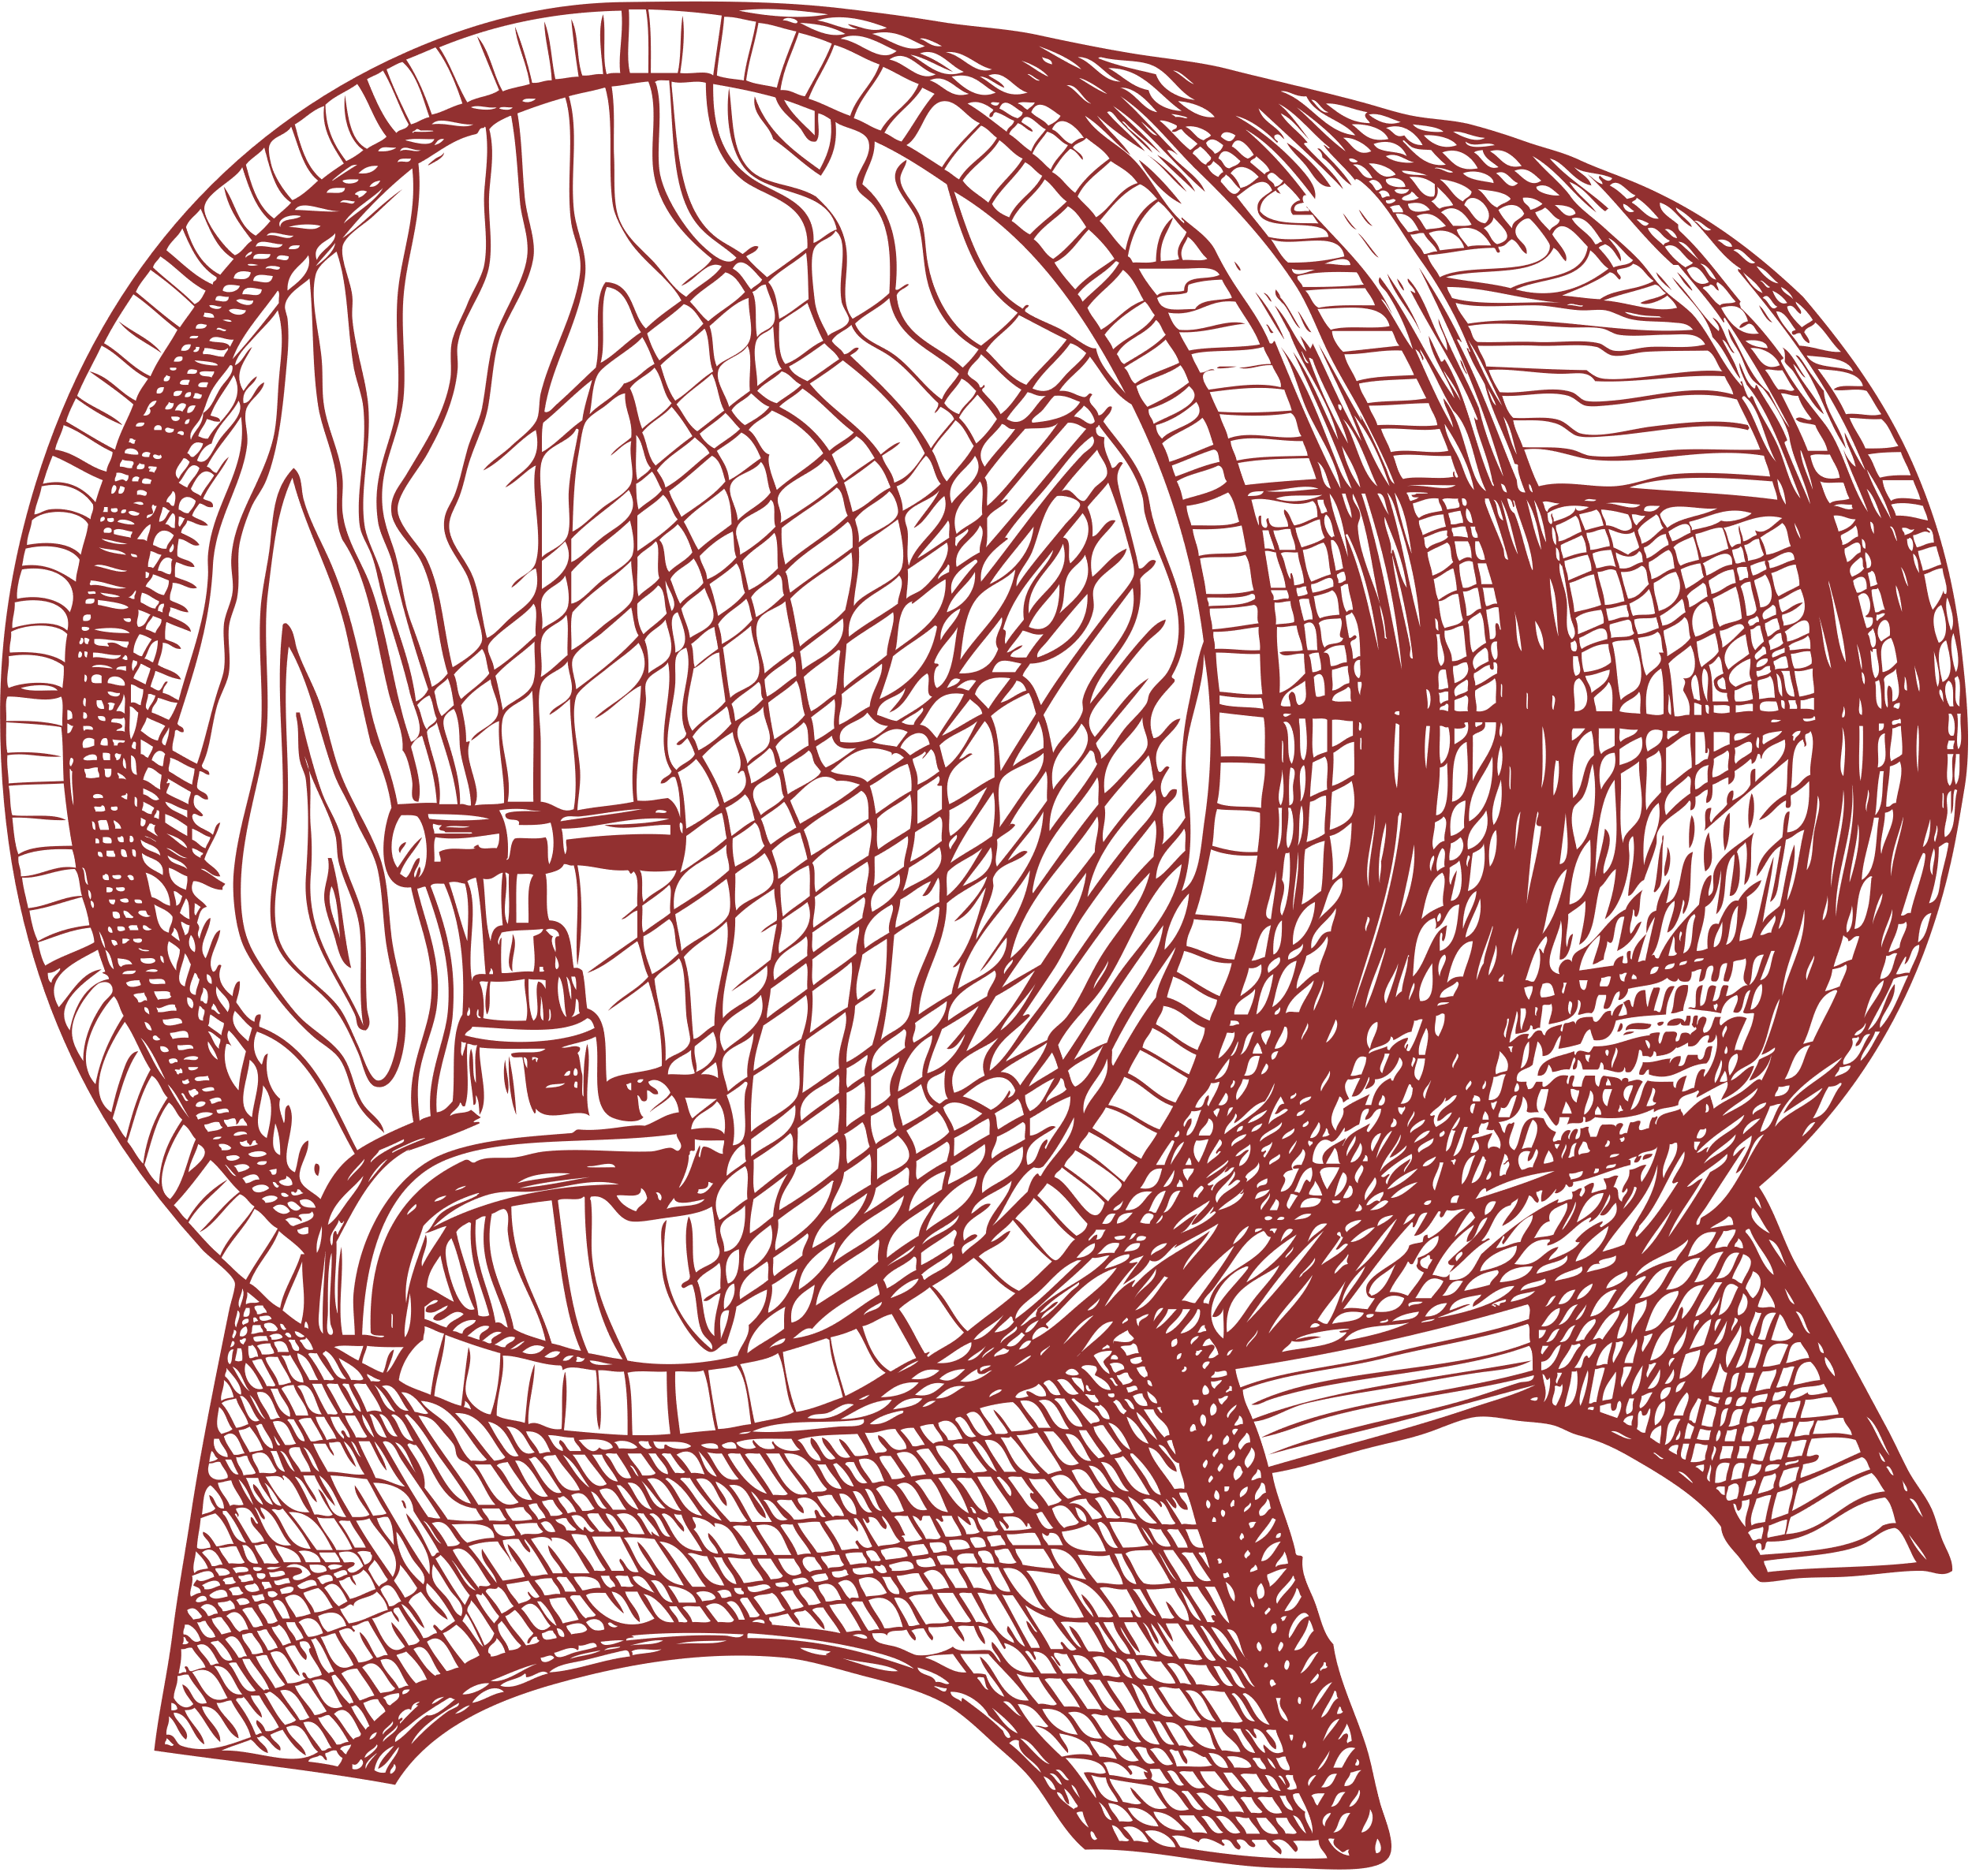
Bayesian Approach?
Posterior Predictive Distributions
Well-studied Dataset
Want to take advantage of wealth of previous studies
Allow for probabilistic statements about results (naturally fascinating as biostats students)

Slide 13
Rationale
Naturally, start off with choice of prior:
Agyemang et al. fit several models for logistic regression and provided parameter and variance estimates → Have lots of data, so natural decision to use Normal prior
Problems?
Different prior distributions?
Pool different estimates?
Power priors?
Is this prior even good?

Slide 14
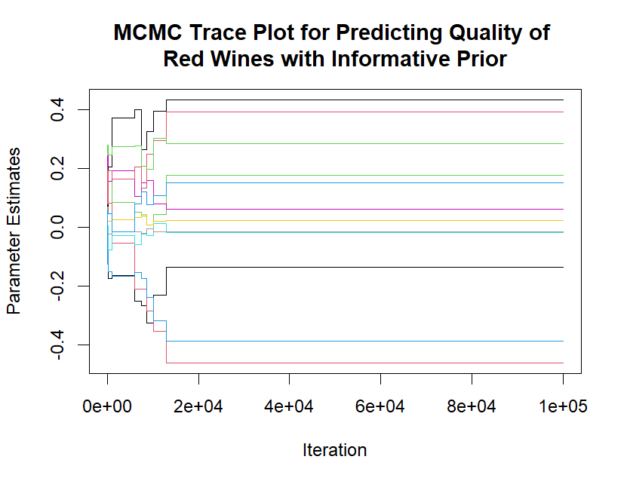
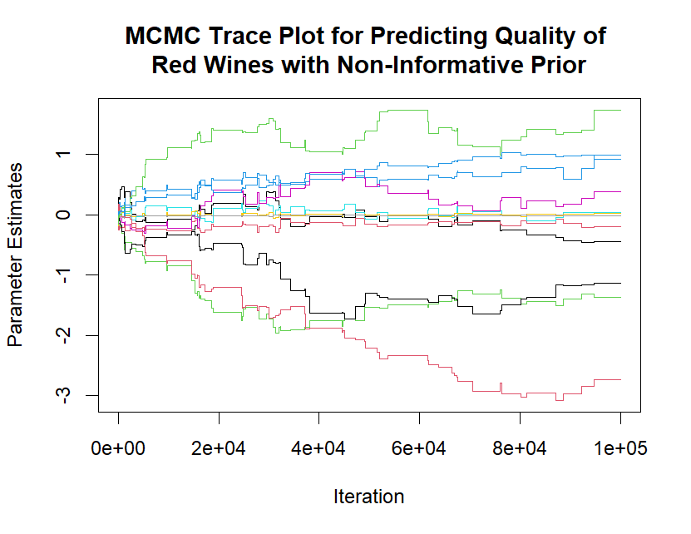
Trace Plots for Predicting Quality of Red Wines

Slide 15
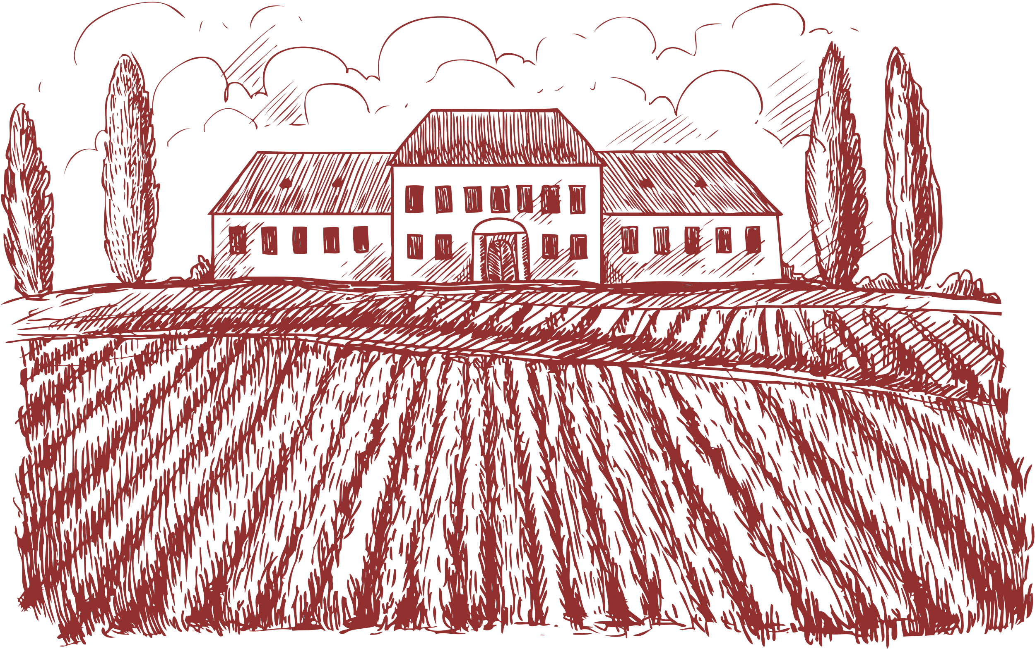
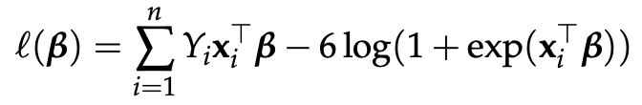
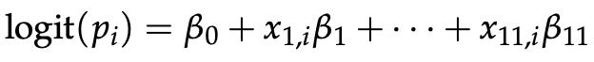
Binomial Regression
with Newton Raphson
Goals
Link Function
Want to fit binomial regression
Picking the Proper Link
Quality ranges from 3 to 9, subtract 3 such that our outcomes follows:
Y = (0, …, 6)
A natural choice is the canonical link, for the binomial distribution, this is the logit
Log Likelihood Under the Canonical Link
Binomial Distribution w/ Logit Link
Elaborate on what you want to discuss.

Slide 16

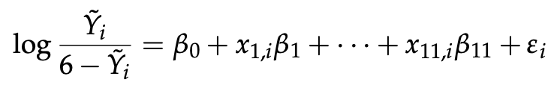
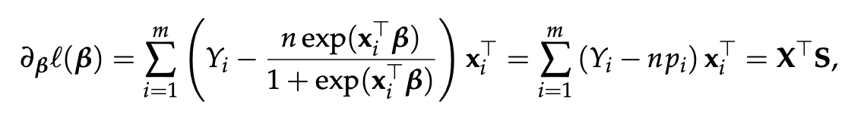
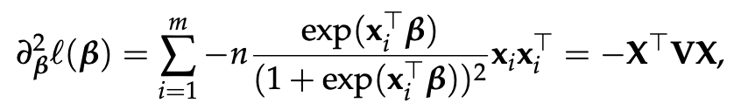
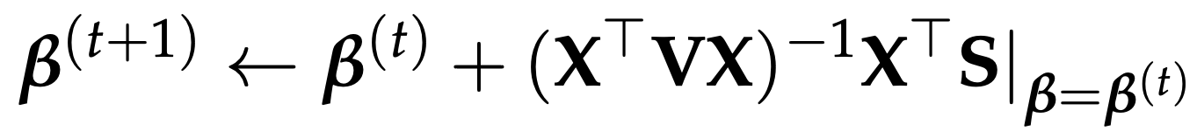
Fitting via Newton Raphson
1. Fit an initial linear model with transformed response (closed form solution)
2. First and second derivatives are as follows:
3. NR update with tolerance 1e-10
then follows:

Slide 17
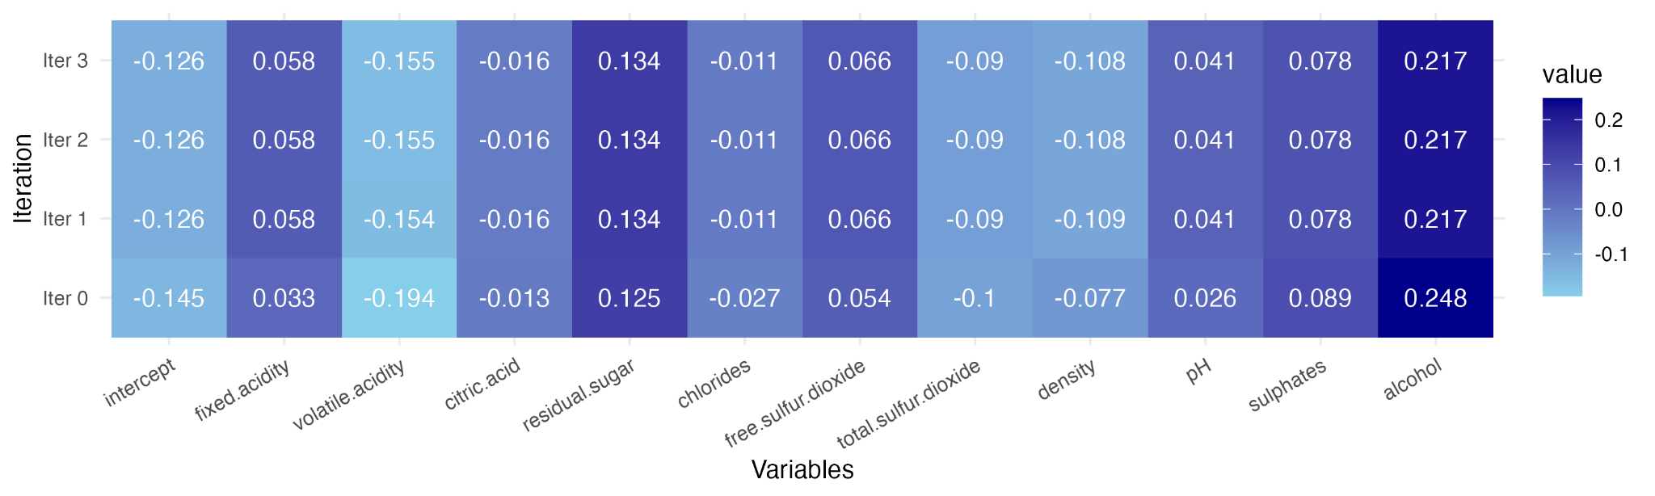
The Fitted Model
Newton Raphson converged in 3 iterations, with iteration 0 being the initial estimate from the specified linear model.

Slide 18
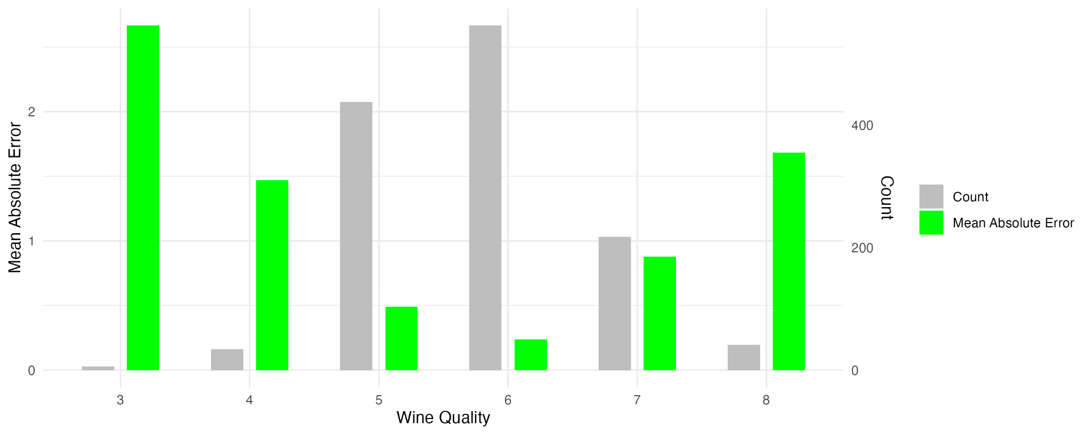
Performance on the Test Set
Imbalanced wine quality scores
More accurate for common wine qualities
Overall MAE: 0.518

Slide 19
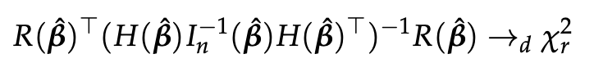
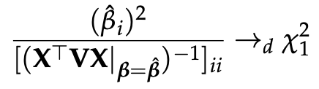
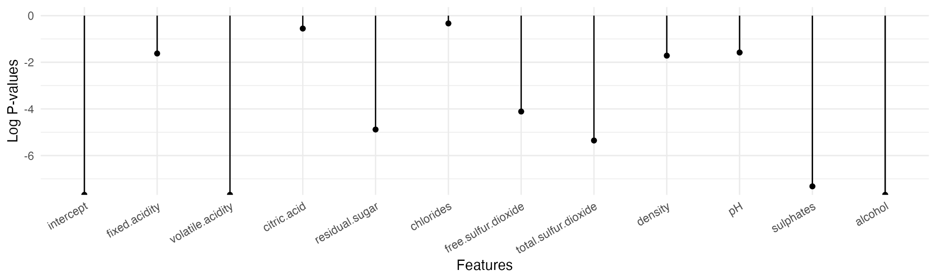
Testing Significant Features
Perform the Wald test for each feature:
H₀: the 𝑖th feature can be removed.
H_{a}: the 𝑖th feature cannot be removed.

Slide 20
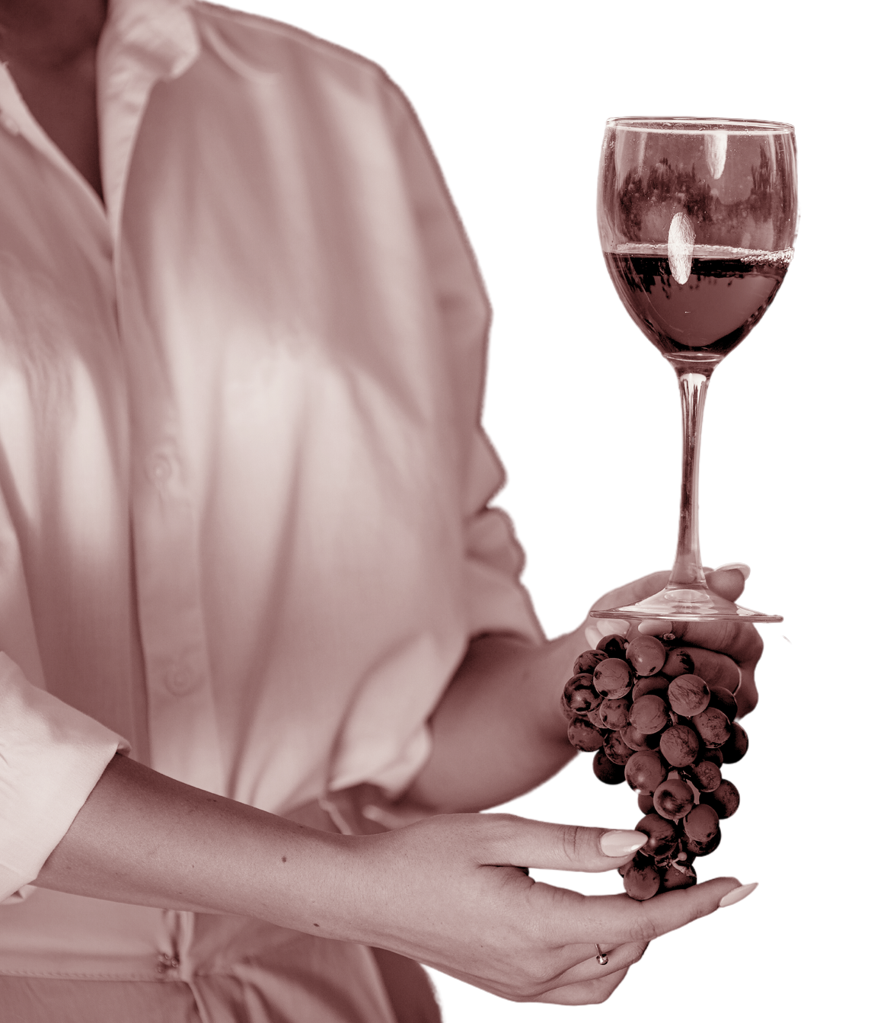
Support Vector
Machines

Slide 21
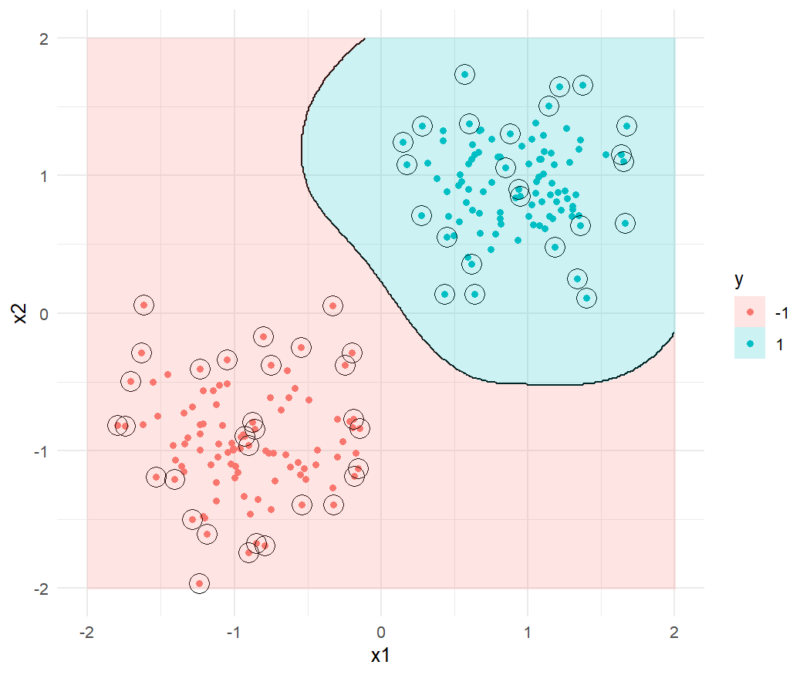
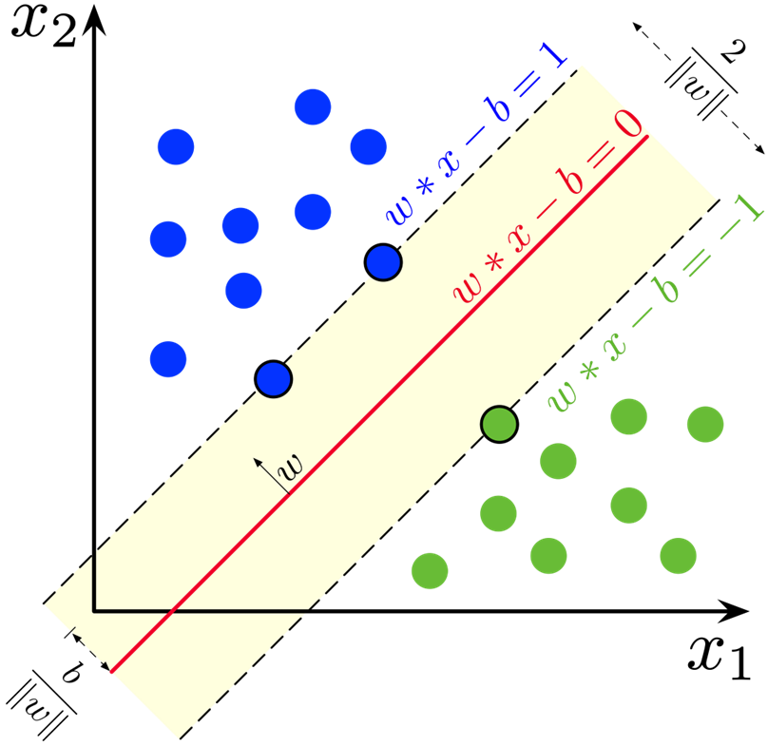
Linear and Radial Kernels

Slide 22
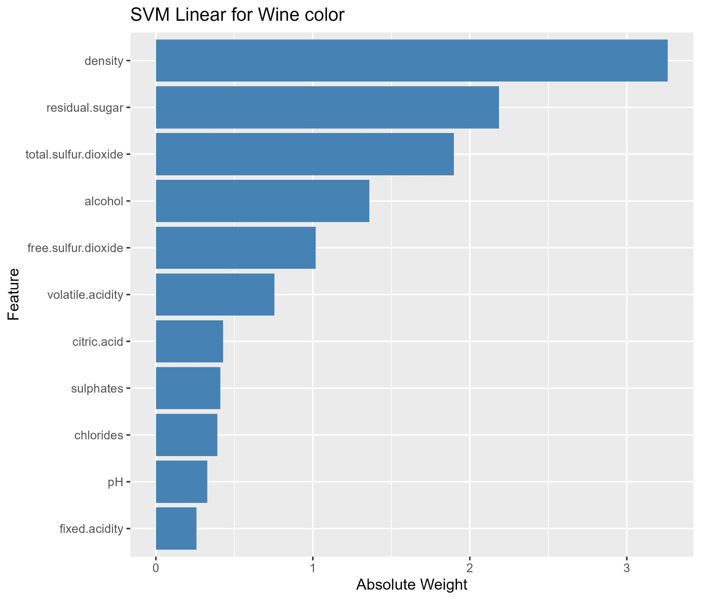
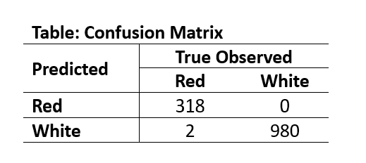
Outcome: Wine Color, Linear Kernel

Slide 23
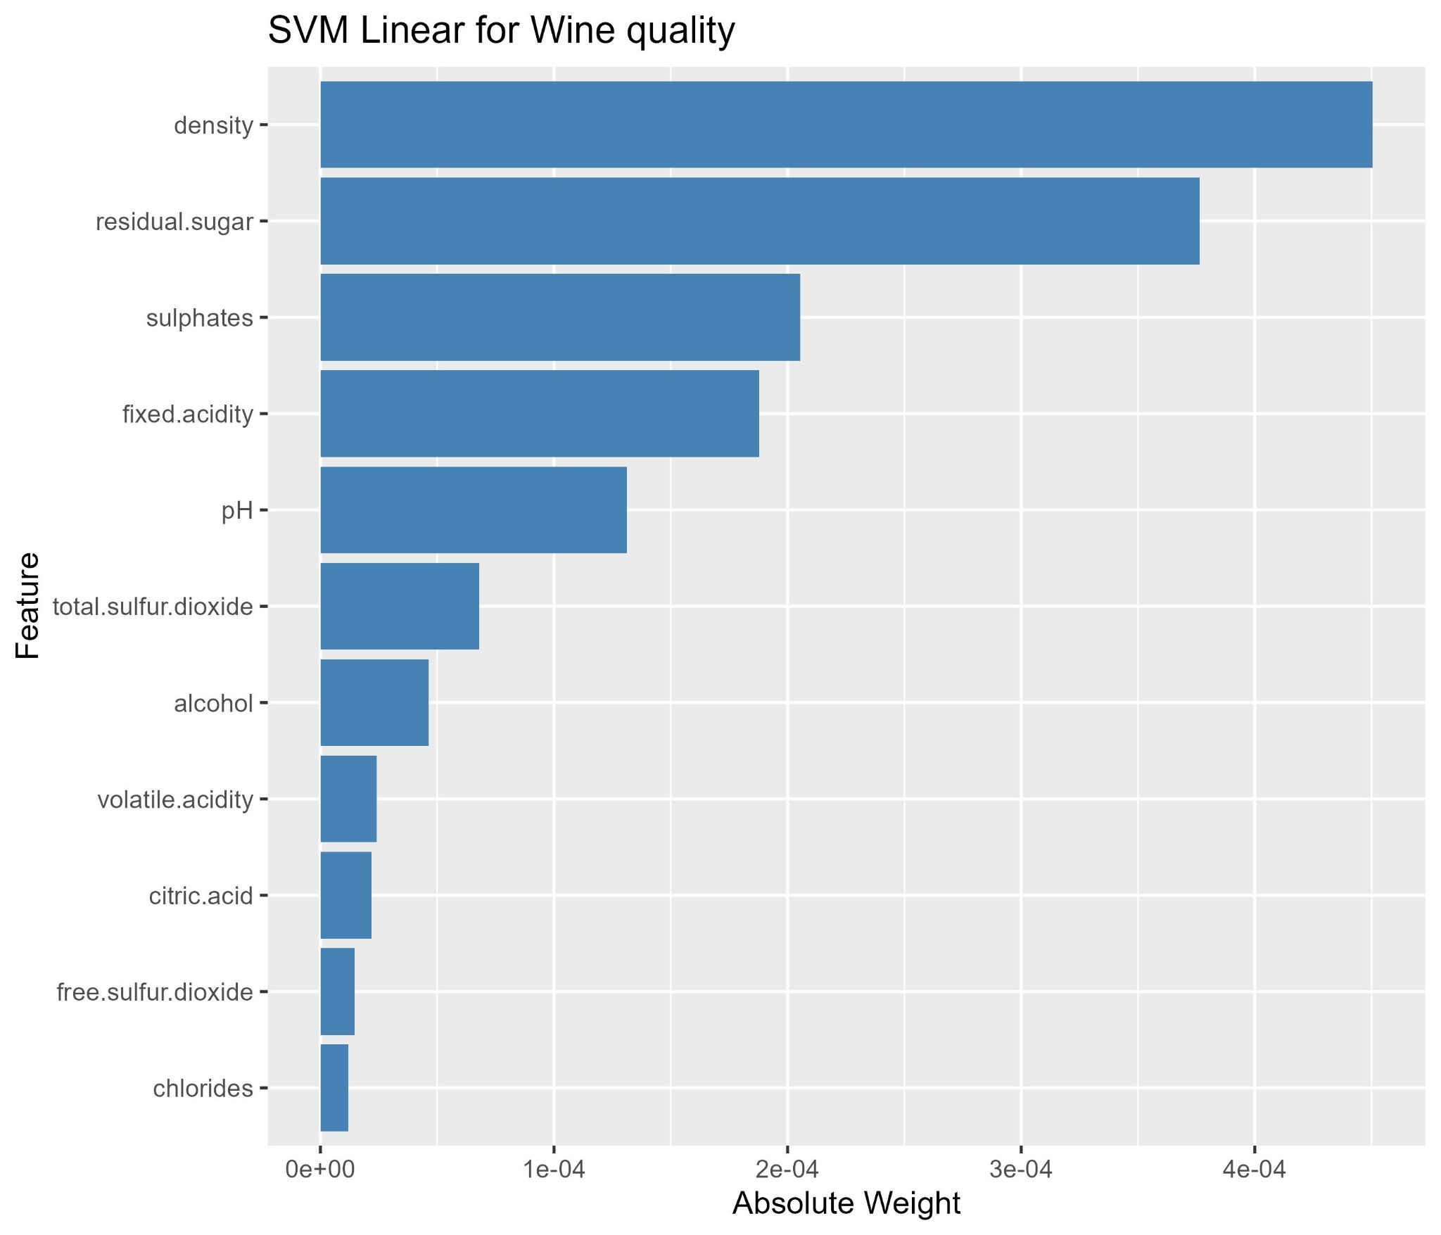
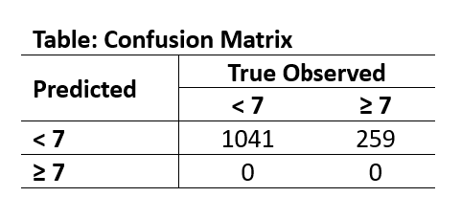
Outcome: Wine Quality, Linear Kernel

Slide 24
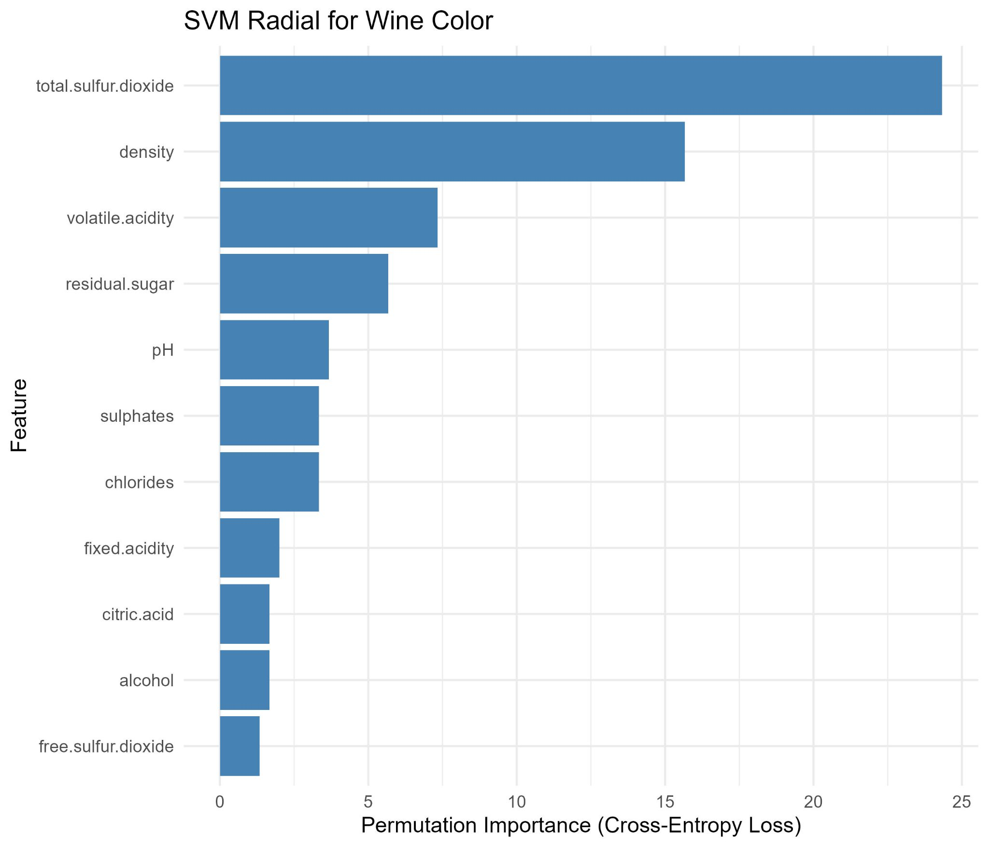
Outcome: Wine Color, Radial Kernel

Slide 25
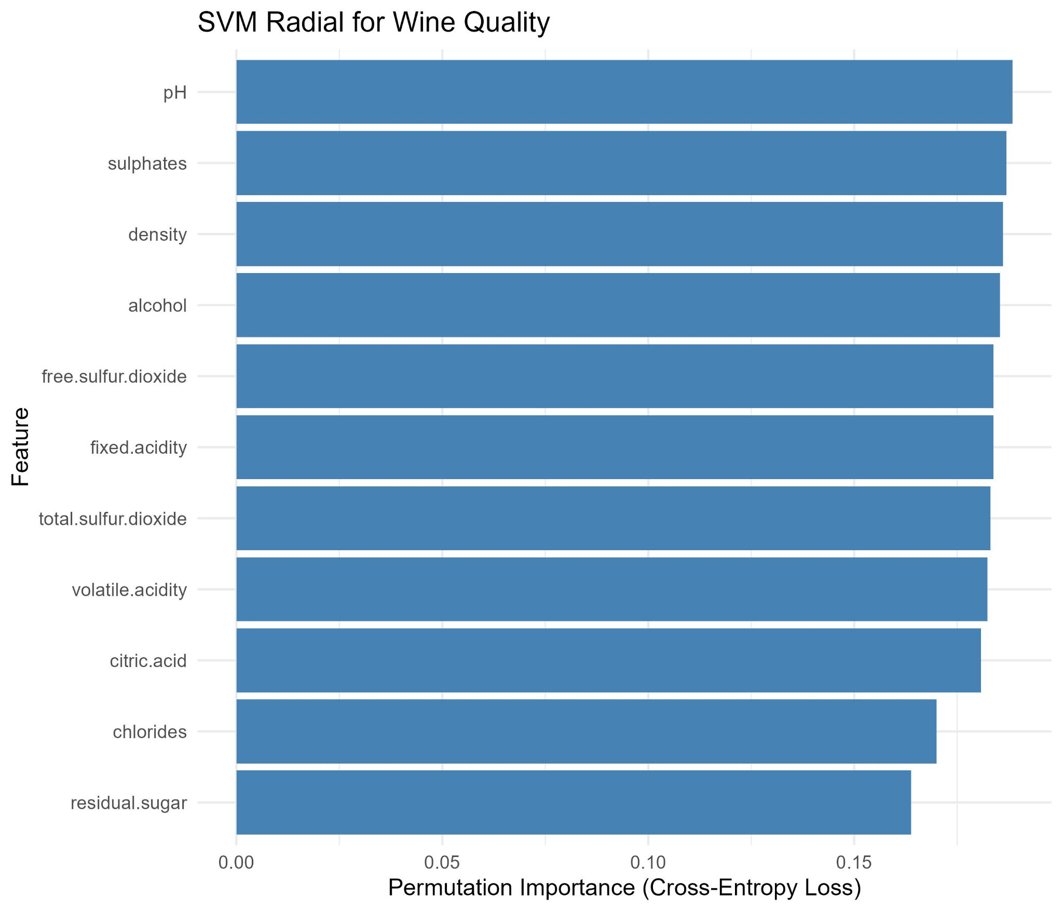
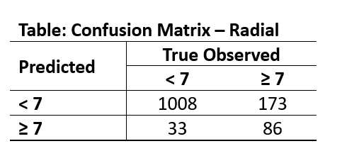
Outcome: Wine Quality, Radial Kernel

Slide 26
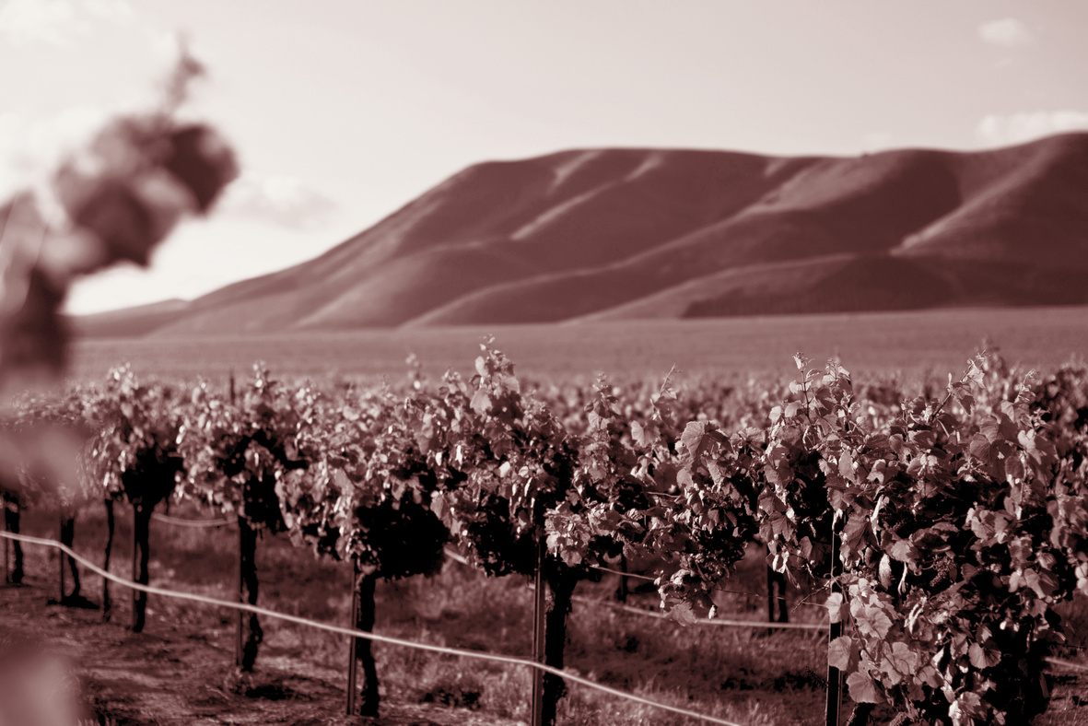
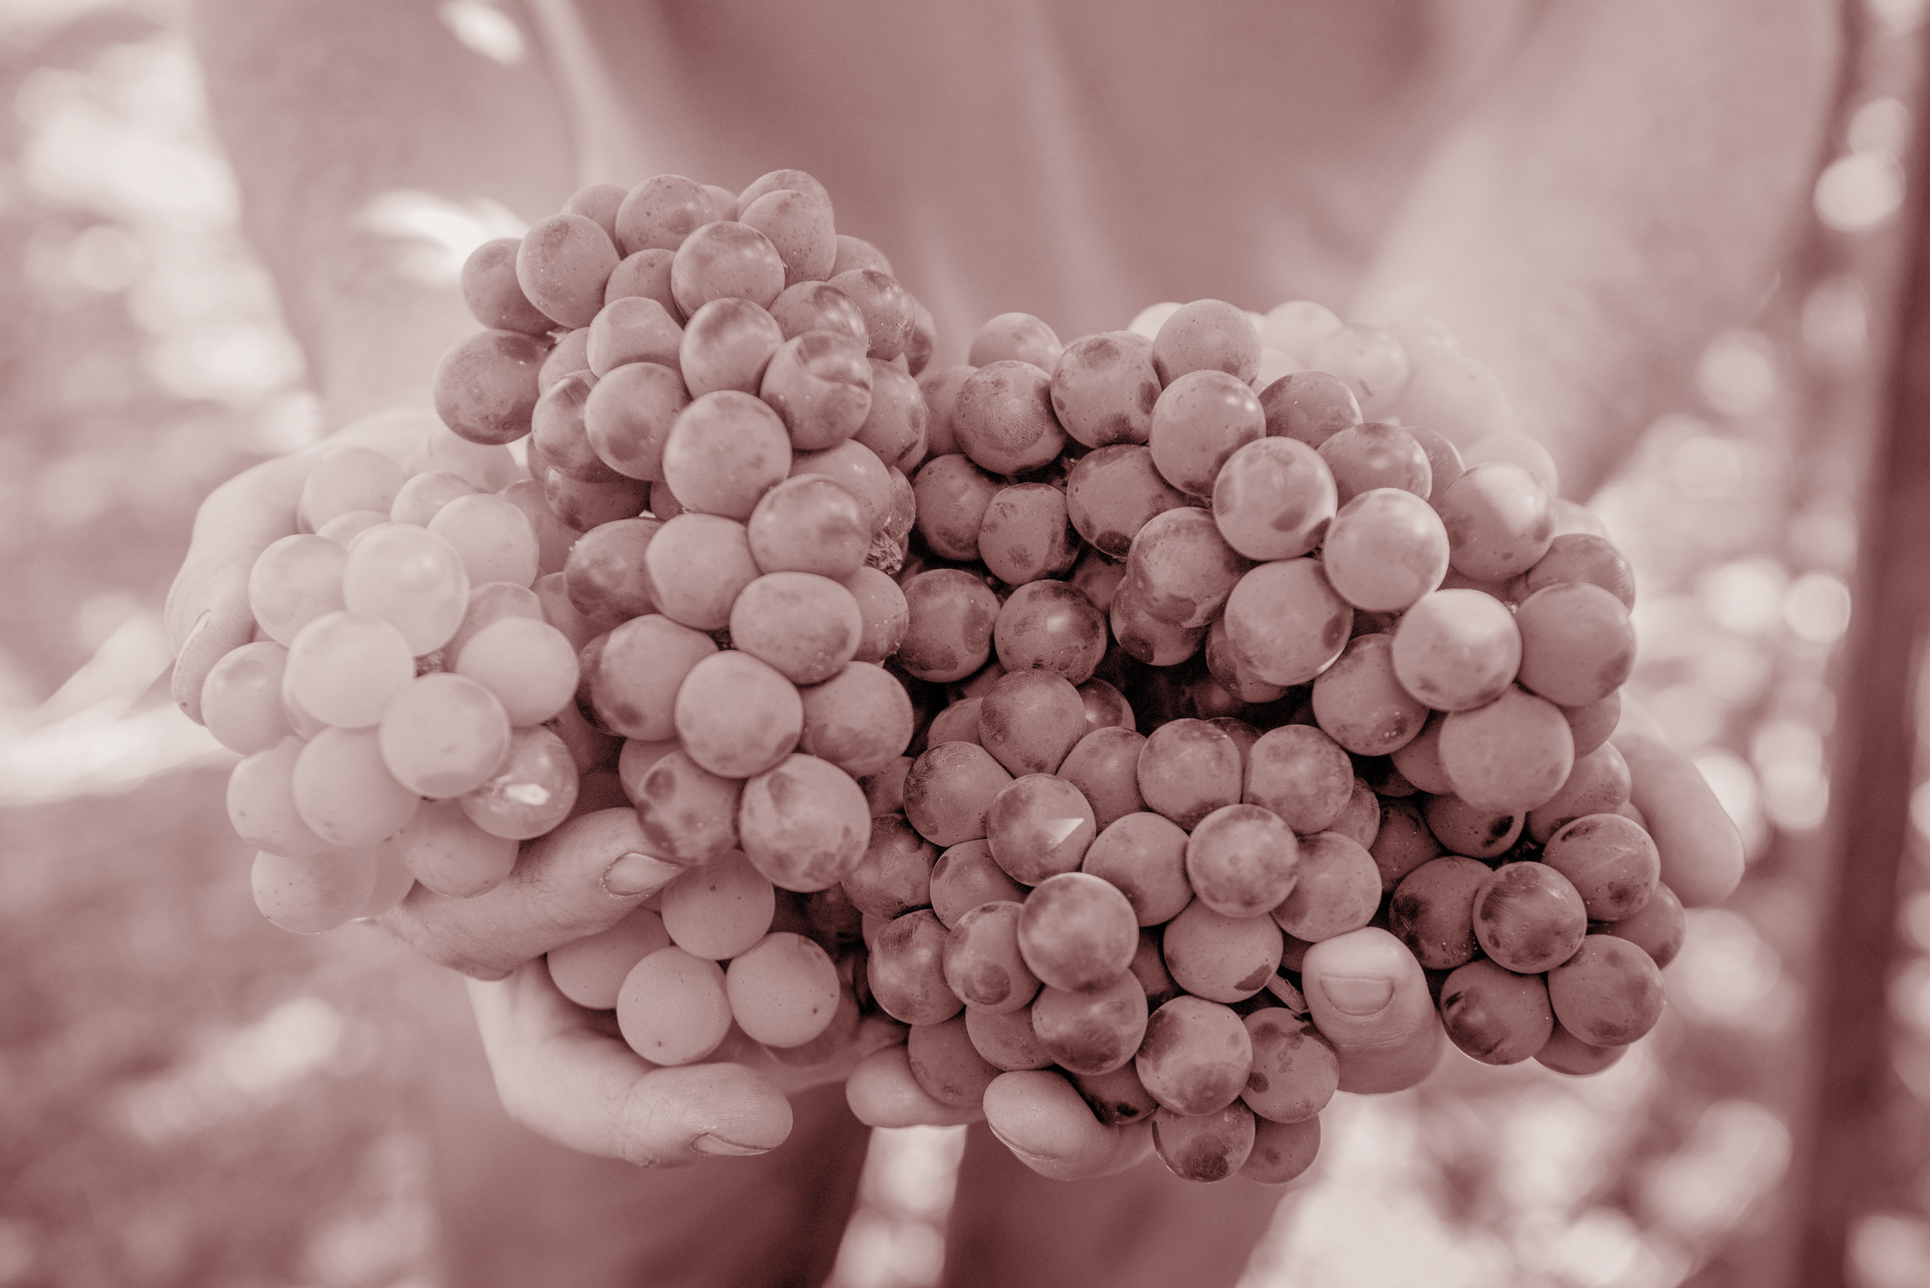



Multi-layer Perceptron (MLP)

Slide 27
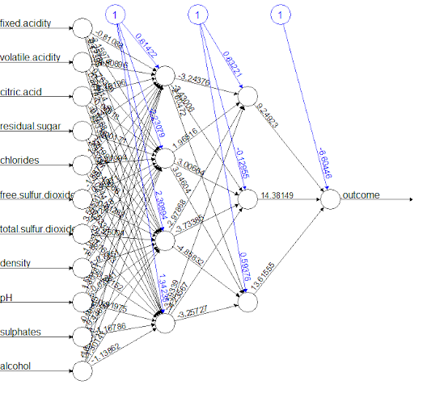

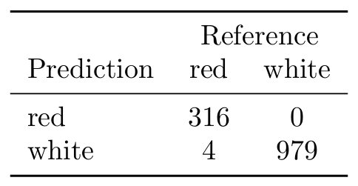
Wine Color
1. Nine network architectures with two hidden layers:
⇒ Then, employ logistic activation function.
Layer 1 ∈ {5, 4, 3}
Layer 2 ∈ {3, 2, 1}
2. Evaluate each with 5-fold CV optimizing ROC
Model with the hidden unit (4, 3) achieved the highest cross validation performance

Slide 28
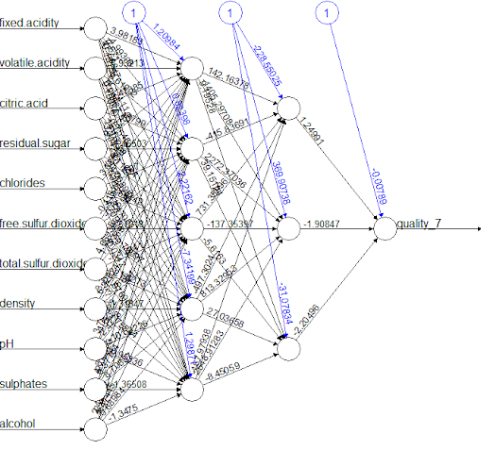
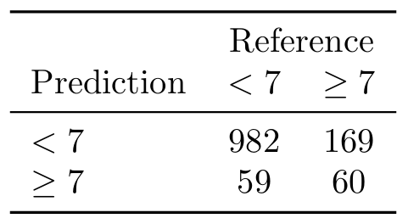
Wine Quality
1. Nine network architectures with two hidden layers:
⇒ Then, employ logistic activation function.
Layer 1 ∈ {5, 4, 3}
Layer 2 ∈ {3, 2, 1}
2. Evaluate each with 5-fold CV optimizing ROC
Model with the hidden unit (5, 3) achieved the highest cross validation performance

Slide 29
01
Introduction
02
Methodology
03
Conclusion
The Problem
The Solution
Data Description
Logistic Regression
Bayesian MCMC
Newton Raphson
SVM & MLP
Comparison
Conclusions
Future Work

Slide 30
Comparison of Methods
Method | Wine Quality |  |  | Wine Color
 | Accuracy | Precision | Recall | Accuracy | Precision | Recall
Logistic Regression | 0.8085 | 0.5431 | 0.2432 | 0.9969 | 0.9969 | 0.9906
Bayesian Logistic Regression | Inf: 0.7723 No: 0.8023 | Inf: 0.8061 No: 0.8096 | Inf: 0.9424 No: 0.9846 | 0.9577 | 0.9623 | 0.9816
SVM | L: 0.8008 R: 0.8415 | L: NA R: 0.7227 | L: 0 R: 0.3320 | L: 0.9985 R: 0.9985 | L: 1 R: 1 | L: 0.9938 R: 0.9938
MLP | 0.8246 | 0.6040 | 0.3475 | 0.9969 | 1 | 0.9875

Slide 31
Conclusion
Color: All models demonstrated strong predictive ability.
Best: Logistic regression was selected for its simplicity and interpretability.
Quality: Overall, predicting quality proved more challenging.
Best: Bayesian Logistic Regression showed notable improvement compared to other models

Slide 32
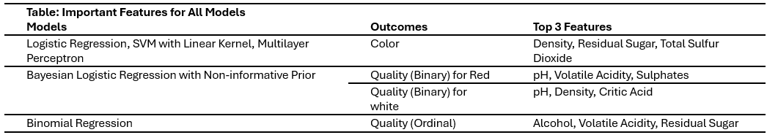
Conclusion
Main Research Aims: What characteristics might good quality wine have? What characteristics might red wines have that whites do not? Do these characteristics differ across color?

Slide 33





Future Work
Look For Any
Possibly Missing
Covariates
Increased Prior
Selection for Bayesian Log-Reg
Differences in
Importance
Across Colors
Drink Lots of Wine
While the given covariates are expansive, they surely do not cover everything a sommelier might find important in a wine.
The utilized prior was not the best, we need to consider ways to incorporate information from advanced ML methods without easy parameter estimates.
So far, we only established a rudimentary grasp of how the same models differ across color.
We have not found the time as a group to go out and drink lots of wine and pretend we’re wine experts.

Slide 34
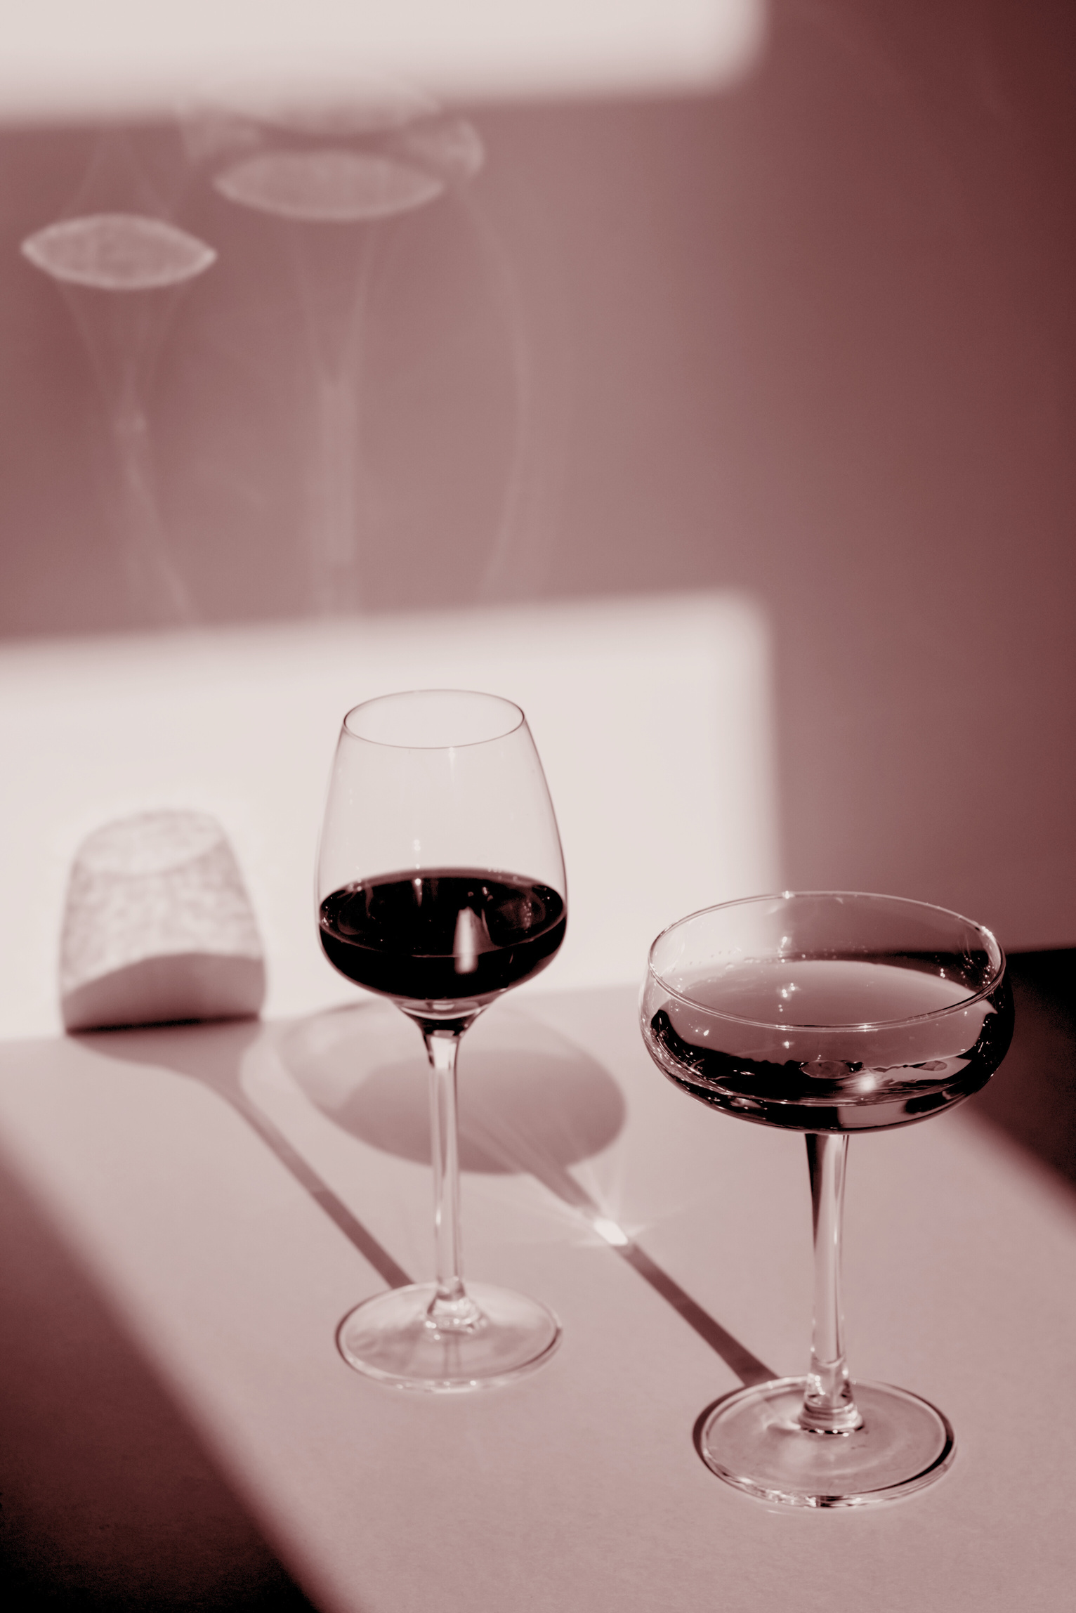
Questions?

Slide 35
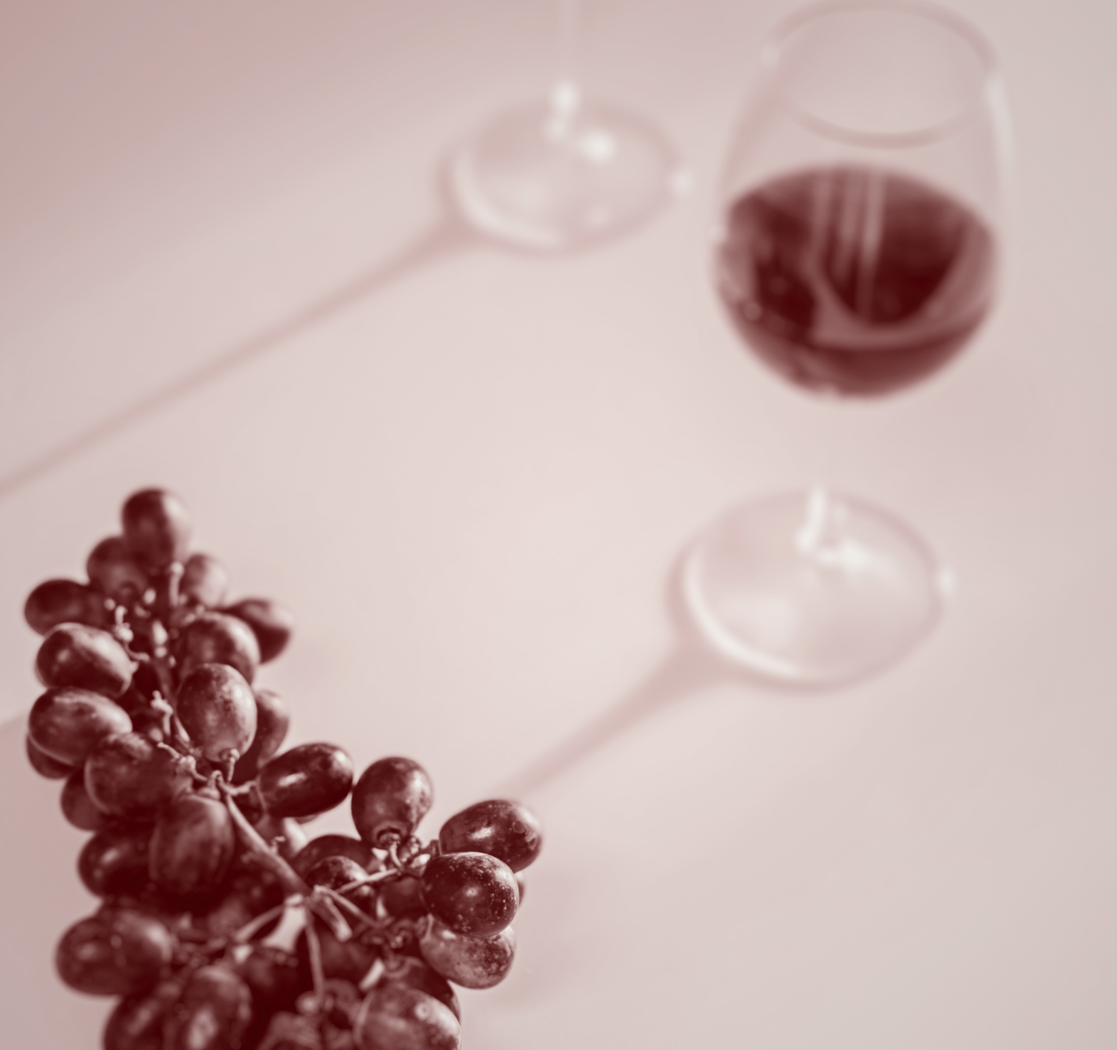

Credits
UCI Machine Learning
Data Repository
Dr. Naim Rashid

